Slide 1
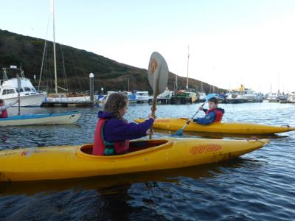
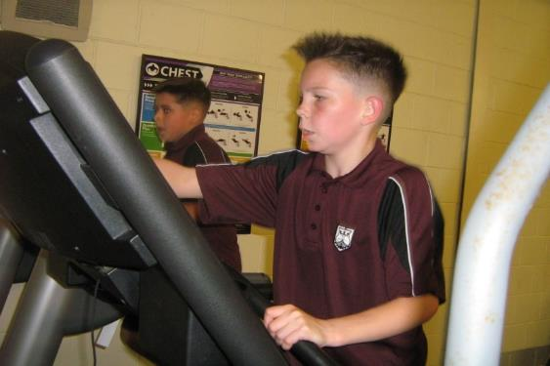
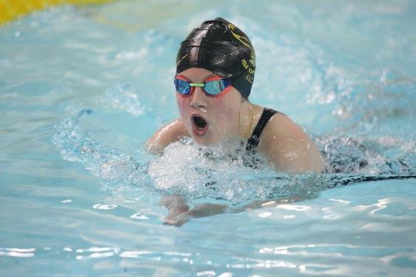
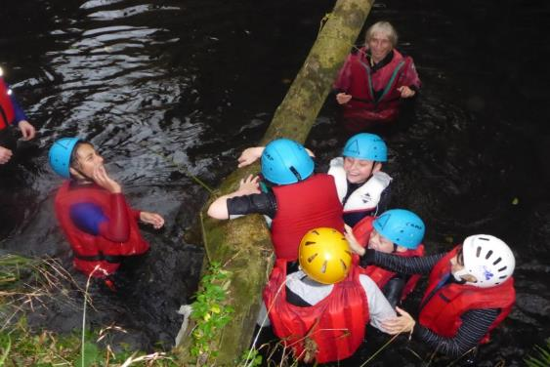
8LSL CHARITY CHALLENGE
Effective participant
creativity
By 8LSL
independence
Team worker

Slide 2
What is it? And why are we doing it?
We have to do a mile or more to complete this challenge and get sponsors all the money we raise will go to a charity of our choice.
Today we come together to tell you about each of our activities and discuss are chosen charity. We will also be telling you what its all about.

Slide 3
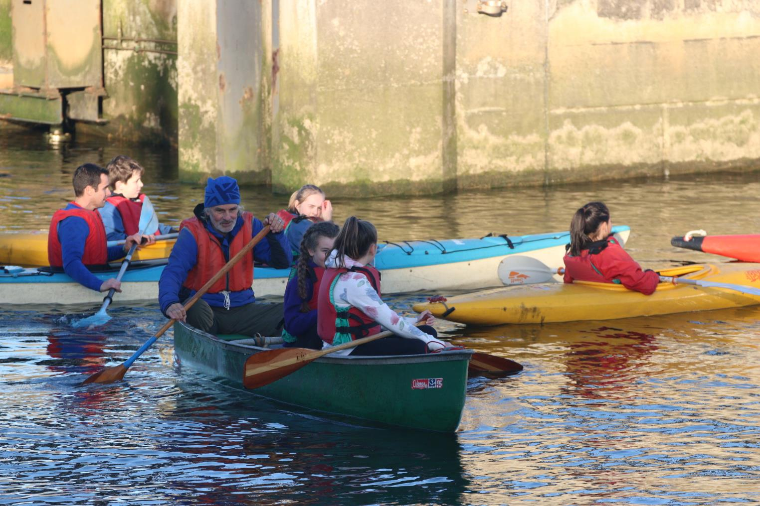
Kayaking

Slide 4
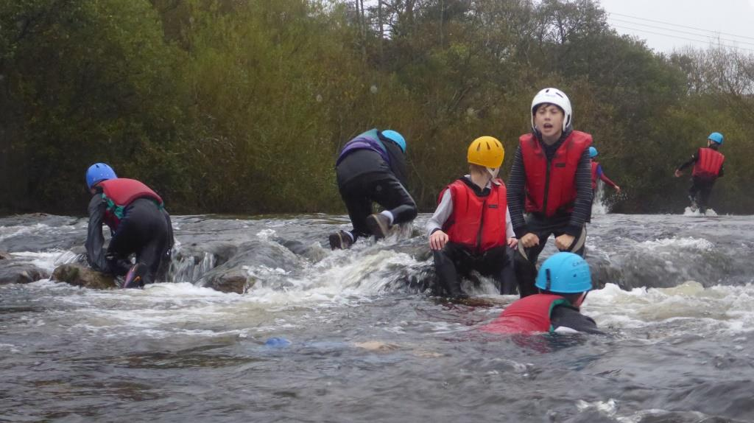
River Walking

Slide 5
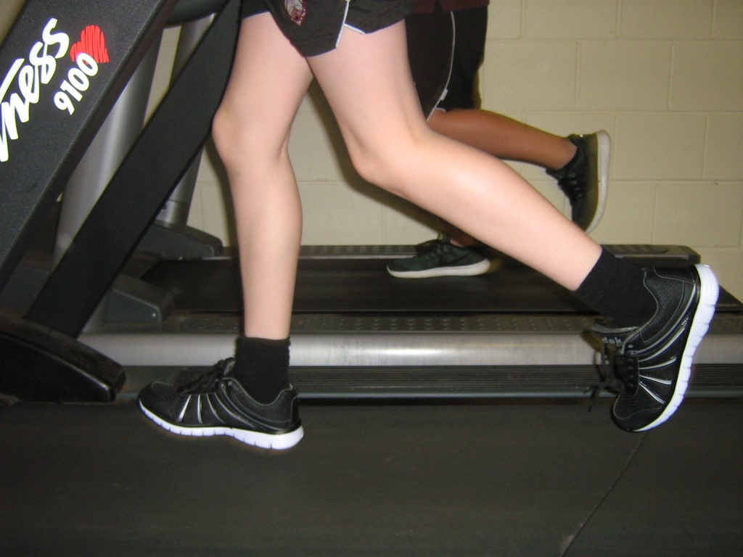
R Running

Slide 6
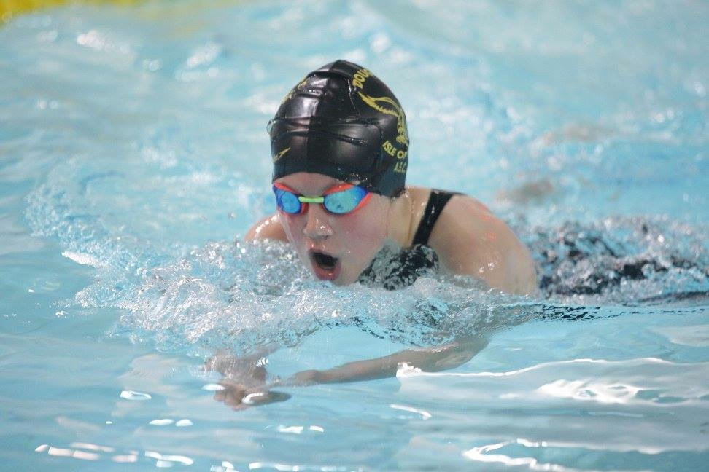
Swimming

Slide 7

We are raising money for Wish Upon a Dream!!!

Slide 8
The charity grants wishes for sick and terminally ill children living on the island e.g. redoing their bedroom or a trip to Disney land.
It opened in 2007

Slide 9
3 mile swim challenge
By Maddie Hemuss

Slide 10
What did I do?
    I did 192 lengths butterfly and it took me 2 hours this equals 3 miles.
I swim for the island and go off Island a lot and go to competitions around England.

Slide 11


These are a few pics of me swimming

Slide 12
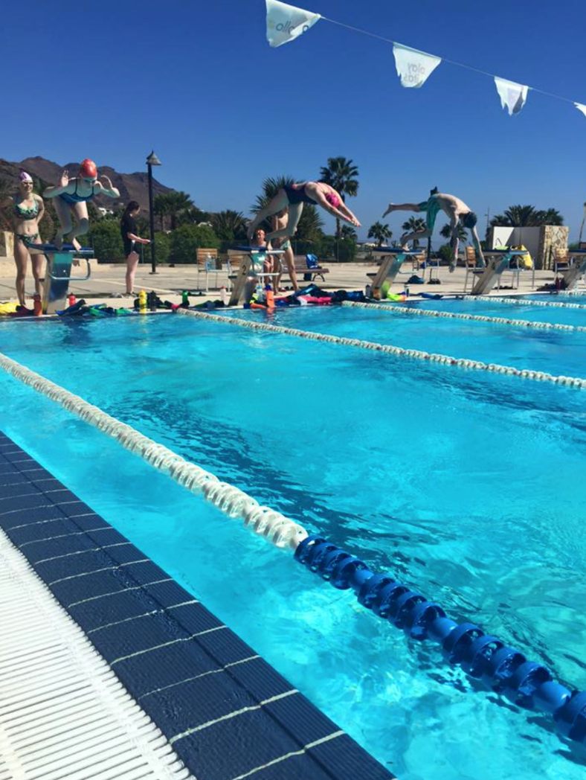
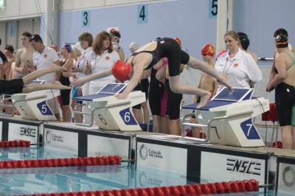
Diving

Slide 13
My PLTS
Time management- I have to do swimming as well as doing my homework.
Commitment- I wake up at 5:30 most morning to go training .
Resilience- when I don’t get a PB I keep going until I get one.

Slide 14
3 MILE HORSE RIDE!!!
Ella May Fargher and Kaitlyn Mclean

Slide 15
3 Mile challenge
Challenge- we rode in the plantation for 3 mile.
We did this together

Slide 16
My PLTS of horse riding.
Resilience- injury- I got kicked by a horse but I kept riding even though it hurt.
Commitment- I go up every day after school to feed her, clean her and put her away.
Time management- I look after Jenny as well as doing jobs at home and doing homework.

Slide 17
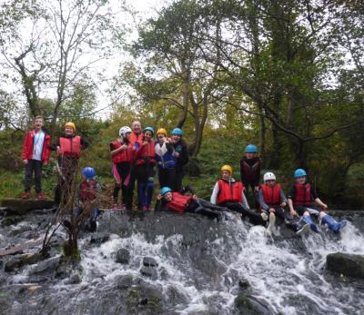
River Walk

Slide 18
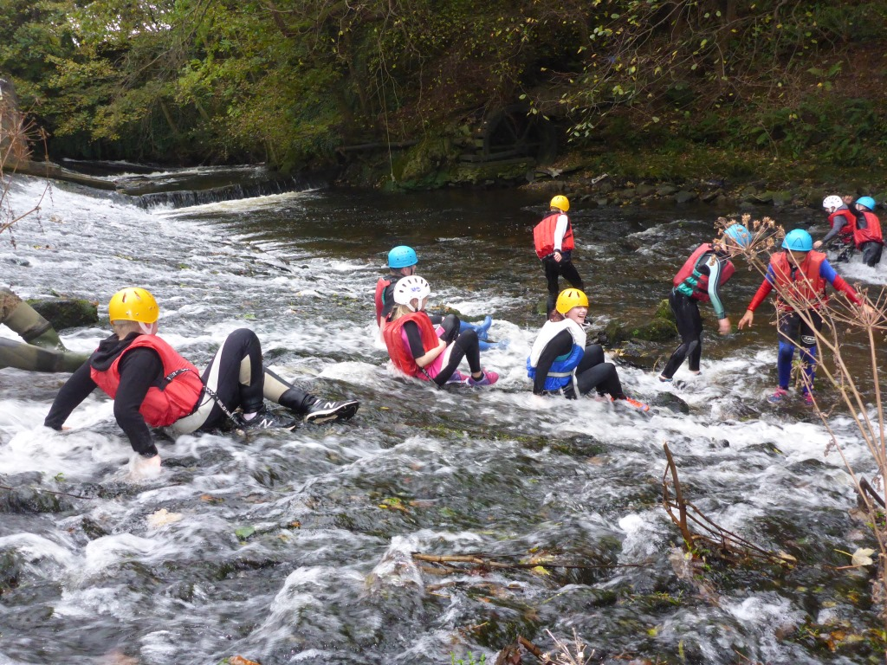

Slide 19
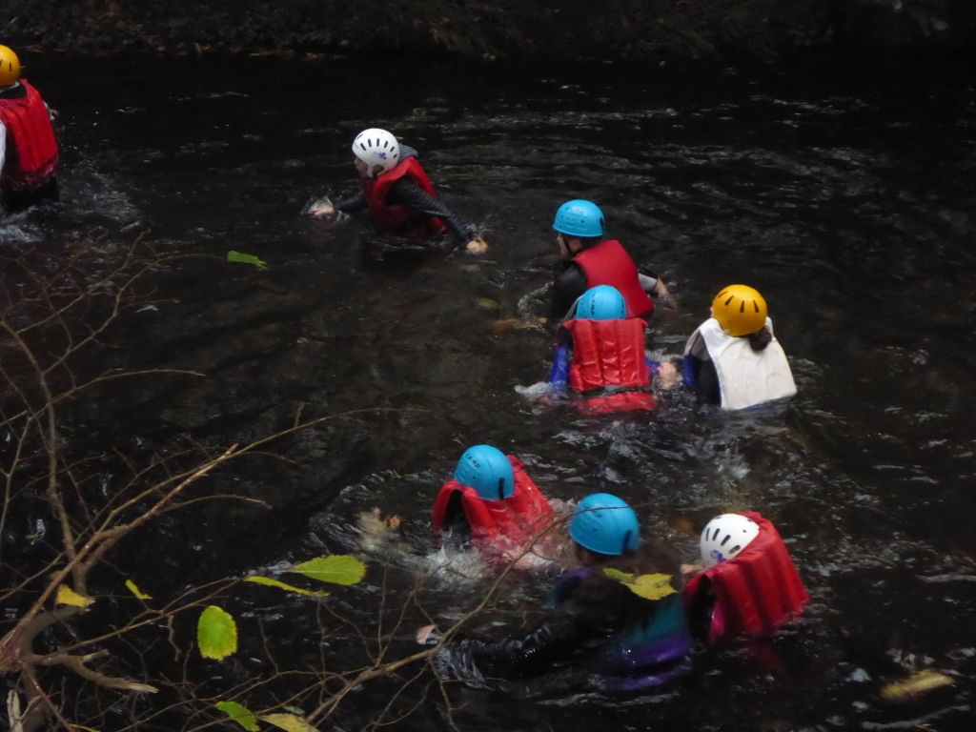

Slide 20

Teamwork

Slide 21
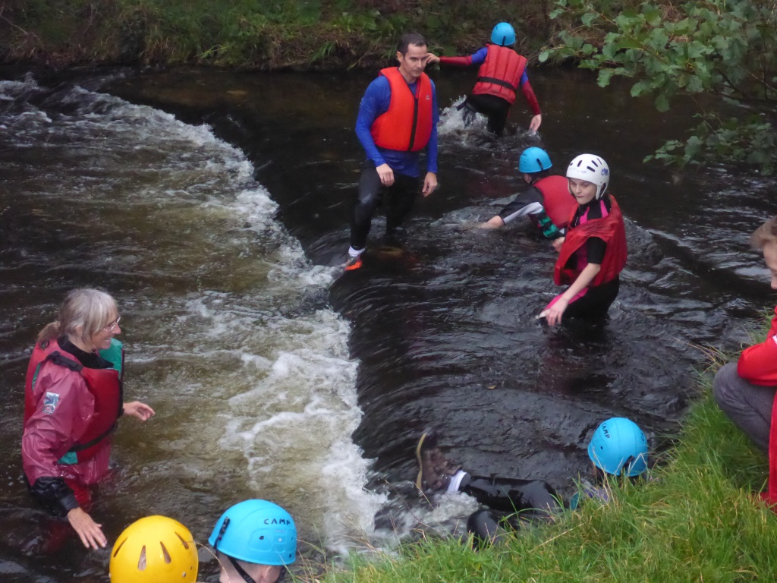

Slide 22
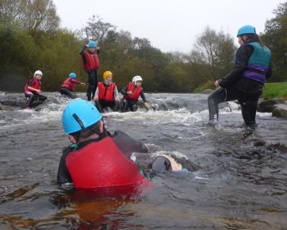
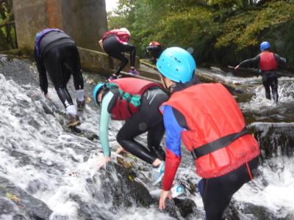
Resilience

Slide 23
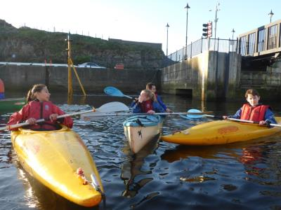
Mile Kayak Challenge

Slide 24
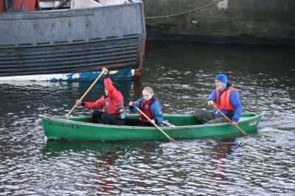
This is the Canadian canoe

Slide 25
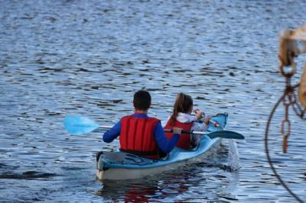
This was the double kayak

Slide 26
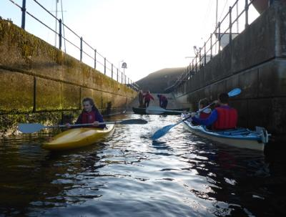
We stopped at the ramp to swap kayaks

Slide 27

This is a picture of us all together

Slide 28
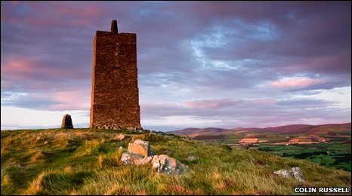
Peel Hill Challenge

Slide 29
What I did
I walked up to Corrin Folly on top of Peel Hill

Slide 30
Mile Run
by Matt and Den

Slide 31
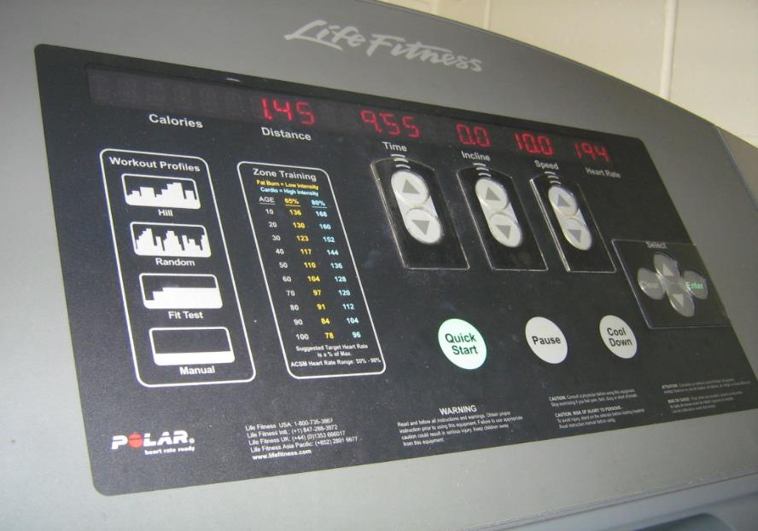

In this challenge we had to run 1mile (1.60 km) in under 20 mins (We did it in 11 minutes)

Slide 32
We did this challenge because
We did this challenge because we have never even stepped on a treadmill before never mind run a mile on one so it would be a real challenge.

Slide 33
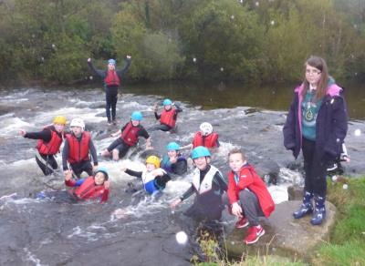

Camera Men/Women

Slide 34
Edited by Harrison Elkins and Rowan Keating

